Slide 1
World Climate Simulation materials and resources available online at:
WorldClimateSimulation.org
More slides available at:
https://www.climateinteractive.org/programs/world-climate/instructor-resources/slide-sets/
Suggested script for presenting slides included in the notes section. If you don’t see the notes when viewing in PowerPoint, look at the bottom of the window for the “Notes” button.
Notes:
This is an information slide for you the facilitator
Look for notes and suggested scripts here!

Slide 2
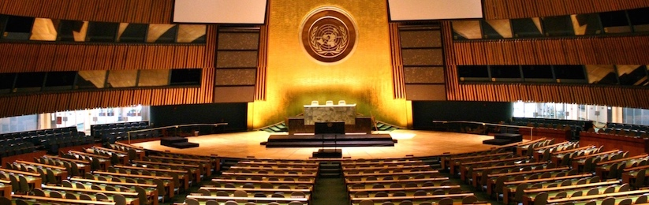

Negotiate a Global Climate Agreement
Notes:
Welcome. Introduce yourself and any others helping to put the simulation together.
Script: You are about to participate in the World Climate Simulation. You will be playing a negotiator at the United Nations climate change negotiations. This simulation was developed by the think tank Climate Interactive, in partnership with the MIT Sloan School of Management and the UMass Lowell Climate Change Initiative

Slide 3
Agenda
Introduction
Roles
Negotiations Round 1
Negotiations Round 2
Debrief
Notes:
Script: The simulation will entail a brief introduction, description of the roles you will play, and 2 or 3 rounds of negotiations, followed by a debrief where we will reflect on the simulation.

Slide 4
3-Region Negotiation Parties
Developed Nations
The United States, European Union, Australia, Canada, Japan, New Zealand, Russia, South Korea, and other former Soviet Republics and eastern European countries.
Developing A
China, India, South Africa, Mexico, Brazil, and Indonesia - large rapidly emerging economies.
Developing B
Over 100 nations in Southeast Asia, Central and South America, Africa, the small islands, and the Middle East. Developing economies, excluding the major rapidly developing nations.
Notes:
Use this slide for the 3 Region mode.
Script: We will have three different groups… <as you read out the groups indicate where they are sitting in the room>

Slide 5
6-Region Negotiation Parties
United States
European Union
Other Developed Nations
Australia, Canada, Japan, New Zealand, Russia, South Korea, and other former Soviet Republics and eastern European countries.
China
India
Other Developing Nations
The nations of Africa, Central and South America, South and Southeast Asia, most of the Middle East, and the small island nations.
Notes:
Use this slide for the 6 Region mode.
Script: We will have six different groups… <as you read out the groups indicate where they are sitting in the room>

Slide 6
We Will Test Pledges in C-ROADS, a Scientifically-Reviewed Policy Simulator
An external review found that CROADS:
“reproduces the response properties of state-of-the-art three dimensional climate models very well”
“Given the models capabilities and its close alignment with a range of scenarios published in the Fourth Assessment Report of the IPCC we support its widespread use among a broad range of users and recommend that it be considered as an official United Nations tool.”
Full report: https://www.climateinteractive.org/wp-content/uploads/2014/01/C-ROADS-Scientific-Review-Summary.pdf
Notes:
Script: The unique thing about World Climate is that it uses the C-ROADS climate policy simulator to test the impact that your chosen policies will have on the climate. C-ROADS is used to analyze the actual pledges countries make to the United Nations and is trusted by top decision-makers worldwide. An external scientific review panel reviewed C-ROADS and found that it reproduced results consistent with the Intergovernmental Panel on Climate Change (or IPCC’s) findings.

Slide 7
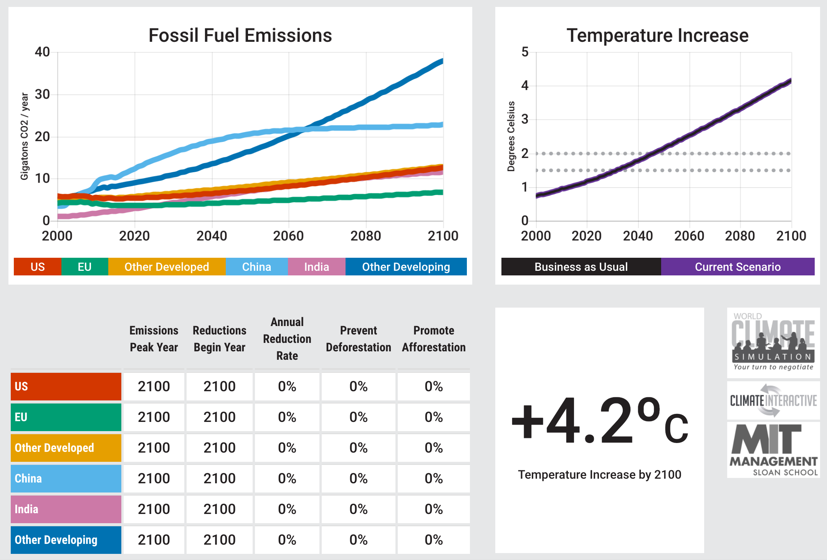

Slide 8
Process
Formulate your negotiating strategy
What are your vital interests?
What is politically feasible in your nation/bloc?
What do you need from the other nations/blocs?
What can you offer them?
Talk to other teams and negotiate for the best possible outcome for your group
Prepare a brief intervention speech to outline your intended plans
Notes:
Script: Now take a few minutes to read through your briefing statements. You will then be given time to formulate your negotiating strategy within your group. Once negotiations begin you are welcome to negotiate policies with other teams to determine the best possible outcome. <give participants time to read through their briefing statements and change your attire to be prepared for the UN Secretary General’s opening remarks - 10 minutes>

Slide 9
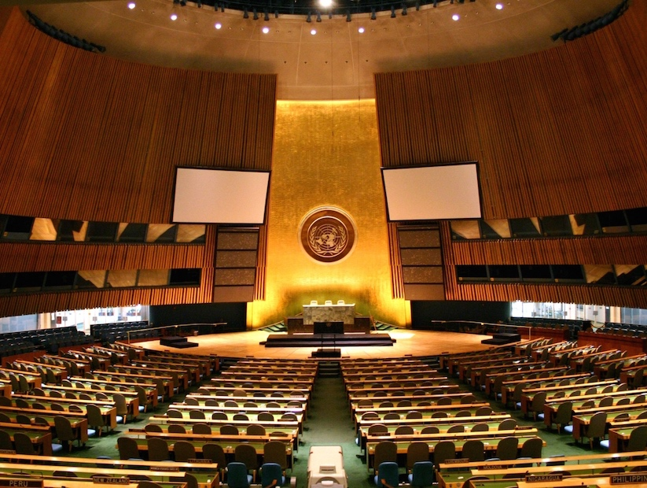
World Energy
Welcome
Notes:
Have someone introduce the UN Secretary General or appear at the podium with a diplomatic demeanor and call the room to attention.
Script: Distinguished delegates, it is with great honor that I welcome you to the Conference of Parties to the United Nations Framework Convention on Climate Change (UNFCCC). As the Secretary General of the United Nations [or Executive Secretary of the United Nations Framework Convention on Climate Change (UNFCCC)], I want to start by congratulating you for forging an agreement in Paris in 2015, which guides us towards achieving a goal of keeping the rise in global temperatures well below two degrees Celsius.
As I look around the room today, I see delegates who are younger than I am and who, within your lifetime and, certainly, within the lifetime of your children, will be faced with the consequences of our decisions here today. I ask you for nothing less today than to feel the full weight of your decisions on your future and the future of generations to come. What is the planet that you will leave to the future?
Your task is straightforward: in order to avoid dangerous climate change, you must achieve emissions reductions that will stabilize temperature increases well below two degrees Celsius and allocate at least a hundred billion dollars per year for climate financing for those who need it most.

Slide 10
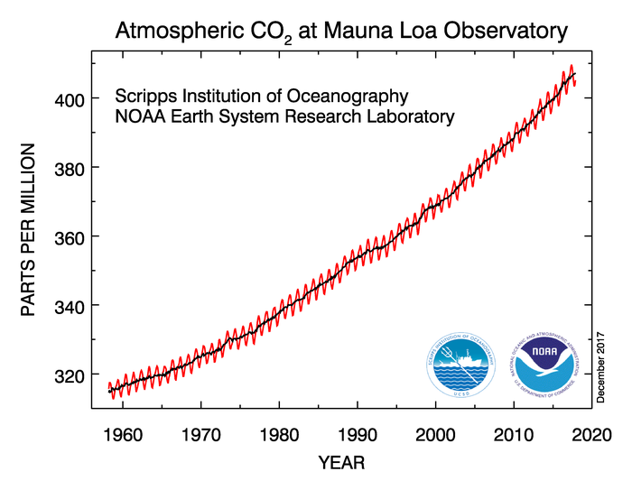
Increases in the concentration of CO₂ in the atmosphere
410 ppm
(May 2017)
Notes:
Script: Let’s take a look at this challenge. The Mauna Loa Observatory in Hawaii, United States, has been measuring the concentration of carbon dioxide (or CO2) in the atmosphere for over 60 years. This graph shows their measurements from 1955 to 2017. As you can see there has been a steady increase in the concentration of carbon dioxide, so that it is now over 400 parts per million.

Slide 11
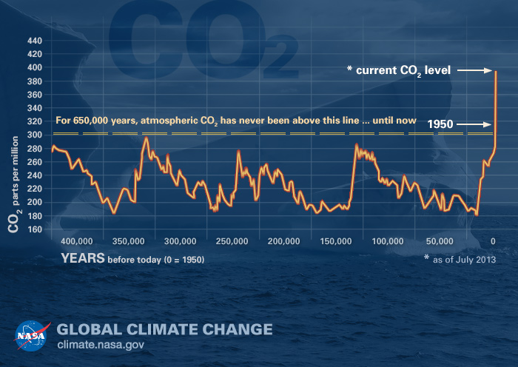
Carbon Dioxide levels are highest in 650,000+ years
Notes:
Script: When scientist study the historical record of carbon dioxide they can go back over 650,000 years. During this time you can see there has been some variability in the concentration of CO2, but that it doesn’t surpass 300 parts per million until 1950. Today we have passed 400 parts per million and concentrations of CO2 are expected to rise if we don’t take immediate action. What we are seeing is unprecedented.

Slide 12
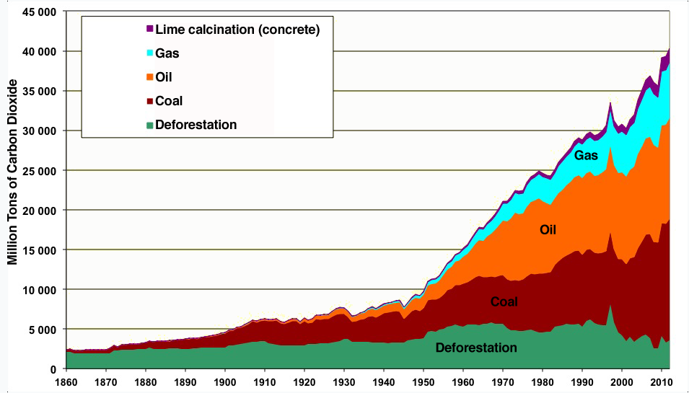
CO₂ Emissions by Source 1860-2012
Source: Data from BP Statistical review, compiled by Manicore.
Notes:
Script: But where does all the CO2 come from? Any ideas? This graph shows the sources of CO2 from the year 1860 to 2012. You can see at the bottom in green that deforestation has contributed but that it is has not grown substantially and may even be declining. The primary contributor to CO2 emissions, however, are the fossil fuels—coal (which you see in red), oil (in orange), and gas (in teal/orange). Emissions from these fossil fuels have grown significantly in recent decades and driving a large part of the climate change we see.

Slide 13
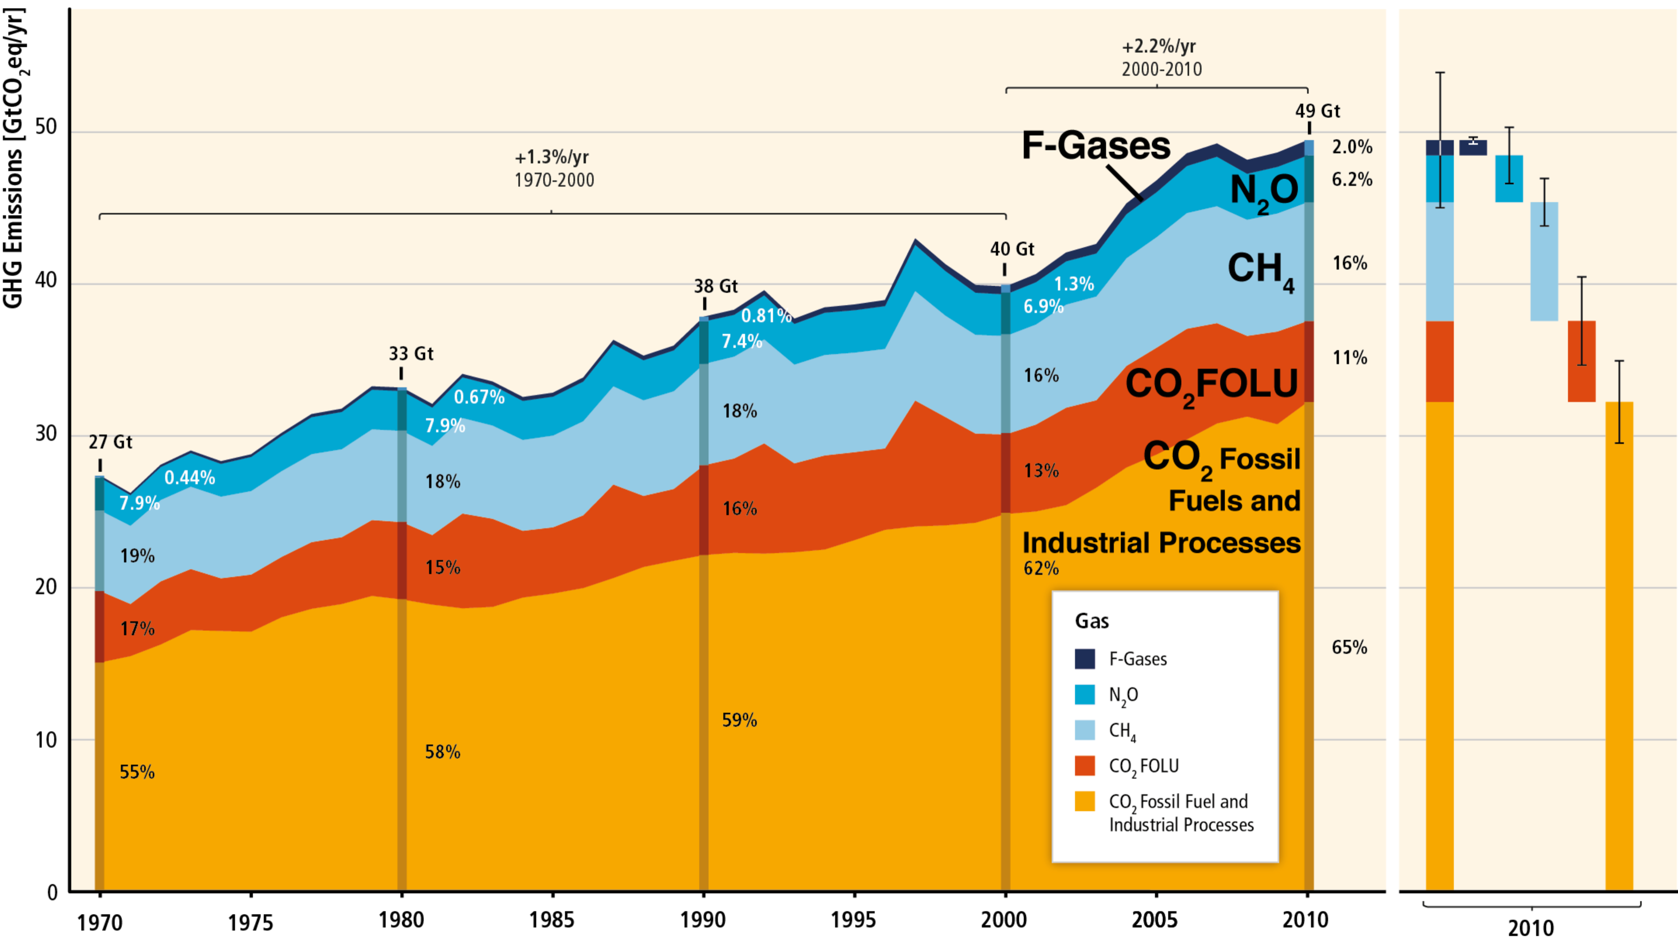
Total Annual Anthropogenic Greenhouse Gases by Gas 1970-2010
Source: IPCC AR5
Notes:
Script: Carbon dioxide is not the only thing that is contributing to climate change. There are also several other greenhouse gases. Here you see the relative contribution from different gases. In orange and red you can see the contribution that CO2 makes from fossil fuels and land use, then in light blue is methane (CH4), then nitrous oxide (N2O), and the F-gases. Agriculture contributes 50% of global methane (CH4) emissions and 60% of global nitrous oxide (N²0) emissions. Heavy industry and manufacturing, as well as consumer goods are sources of N2O and F-gases.

Slide 14
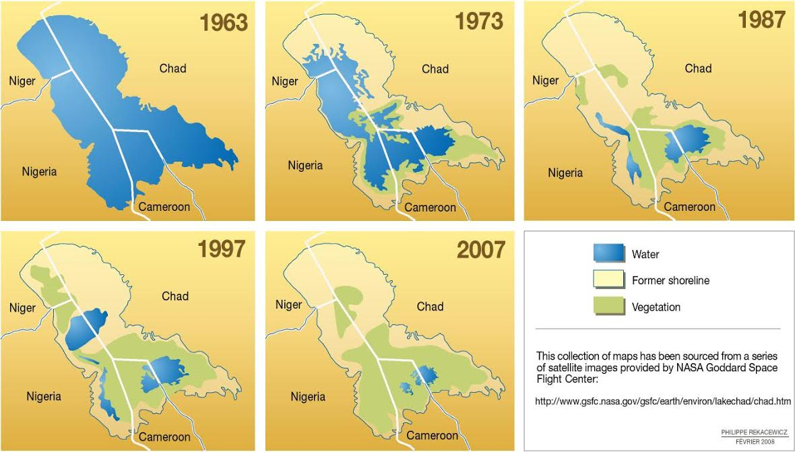
Lake Chad
95% reduction in water surface
Notes:
Script: While there are devastating impacts expected with 4.5 degrees celsius of warming globally, we are already seeing dramatic changes around the world. For example here is a satellite image of Lake Chad in central Africa. In 1972, Lake Chad had an area the size of Rwanda or the state of Vermont. Since then it has lost over 95% of its surface area due to persistent drought. The lake could now fit within the city of San Francisco or Milan. <<Background video on the crisis around Lake Chad - https://www.youtube.com/watch?v=N9oLTOKnDnY>>

Slide 15
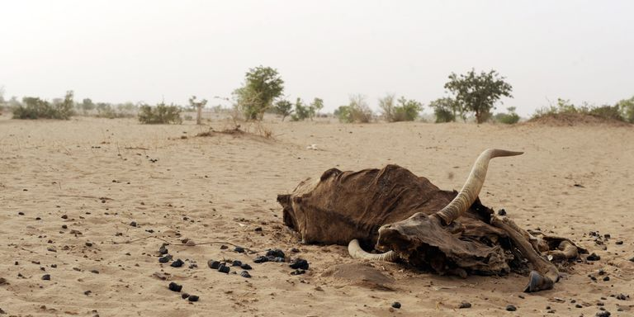
Drought, Sahel… +$10 Billion
2012 - Present
2.5 million displaced
Widespread food insecurity
Notes:
Script: Across the Sahel region of northern Africa a drought that has lasted for four years has created food insecurity which has displaced over 200,000 people. According to the IPCC, by 2020, between 75 and 250 million of people are projected to be exposed to increased water stress due to climate change.

Slide 16
“Climate change could have significant geopolitical impacts around the world, contributing to poverty, environmental degradation, and the further weakening of fragile governments. Climate change will contribute to food and water scarcity, will increase the spread of disease, and may spur or exacerbate mass migration.”
“While climate change alone does not cause conflict, it may act as an accelerant of instability or conflict, placing a burden to respond on civilian institutions and militaries around the world.”
— Quadrennial Defense Review, U.S. Department of Defense, February, 2010
Notes:
Script: Even the United States Department of Defense is issuing alerts about the challenge of climate change and warning that it will have significant geopolitical impacts that can further weaken fragile governments and exacerbate mass migration.

Slide 17
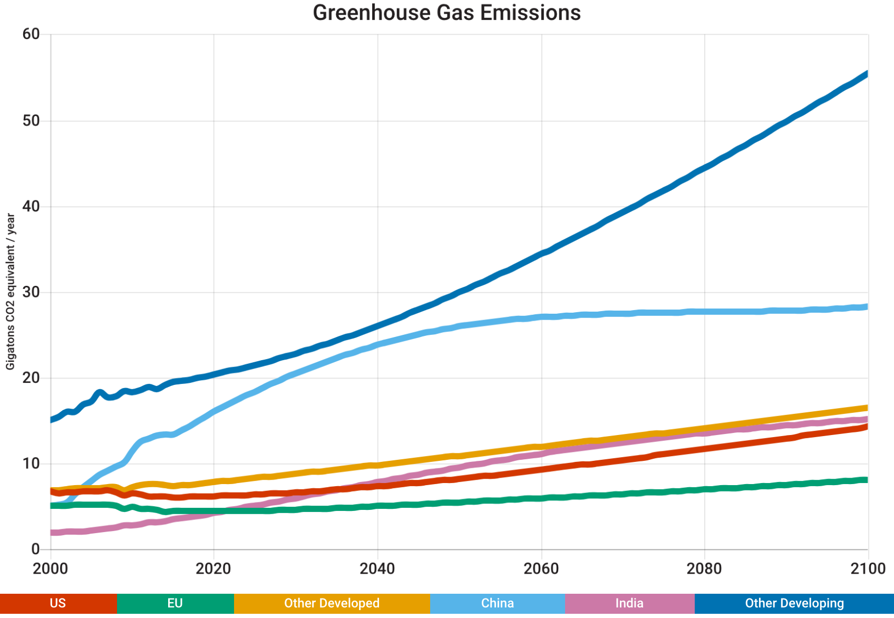
Business as Usual
4.5°C
in 2100
Notes:
Script: If we do not take action, temperatures are expected to rise around 4.5 degrees Celsius by the end of the century. Here is a graph of greenhouse gas emissions from the year 2000, projected to 2100. Each line represents one of your groups. At the top, with emisisons expected to grow rapidly if high carbon development practices are followed, is the Other Developing countries. Then in grey is China. In green, is the Other Developed countries – Japan, Canada, Australia, and Russia. In blue is the United States. In black is India. And in red, is the European Union.

Slide 18
+4 ºC of warming
Multi-meter sea level rise within 50-150 years possible
Widespread increase in the frequency of drought across the globe (~60% increase)
Desertification of Mediterranean Europe
Intense and frequent heat waves and floods in areas
Committed warming (centuries to millennia): + >6 ˚C
Long-term equilibrium sea level rise (millennia): ~13-15 m
Irreversible change
Notes:
Script: If we do not take to reduce our fossil fuel use, we could see severe impacts by the end of the century. For example…
5. C. Prudhomme, I. Giuntoli, E. L. Robinson, D. B. Clark, N. W. Arnell, R. Dankers, B. M. Fekete, W. Franssen, D. Gerten, S. N. Gosling, S. Hagemann, D. M. Hannah, H. Kim, Y. Masaki, Y. Satoh, T. Stacke, Y. Wada, D. Wisser, Hydrological droughts in the 21st century, hotspots and uncertainties from a global multimodel ensemble experiment. Proceedings of the National Academy of Sciences, 111.9(2013): 3262–3267.
6. A. Levermann, P. U. Clark, B. Marzeion, G. A. Milne, D. Pollard, V. Radic, A. Robinson, The multimillennial sea-level commitment of global warming. Proceedings of the National Academy of Sciences 110, 13745-13750 (2013); published online EpubAugust 20, 2013 (10.1073/pnas.1219414110).
7. S. Solomon, D. Battisti, S. C. Doney, K. Hayhoe, I. M. Held, D. P. Lettenmaier, D. Lobell, D. Matthews, R. Pierrehumbert, M. Raphael, R. Richels, T. L. Root, K. Steffen, C. Tebaldi, G. W. Yohe, Climate stabilization targets: Emissions, concentrations, and impacts over decades to millenia. (National Academy of Sciences, Washington DC, 2010), pp. 190.
8. J. Hansen, P. Kharecha, M. Sato, V. Masson-Delmotte, F. Ackerman, D. J. Beerling, P. J. Hearty, O. Hoegh-Guldberg, S. L. Hsu, C. Parmesan, J. Rockstrom, E. J. Rohling, J. Sachs, P. Smith, K. Steffen, L. Van Susteren, K. von Schuckmann, J. C. Zachos, Assessing "dangerous climate change": required reduction of carbon emissions to protect young people, future generations and nature. PLoS One 8, e81648 (2013)10.1371/journal.pone.0081648).
9. Lynas, Mark. Six Degrees: Our Future on a Hotter Planet. Washington, D.C.: National Geographic, 2008. Print.

Slide 19
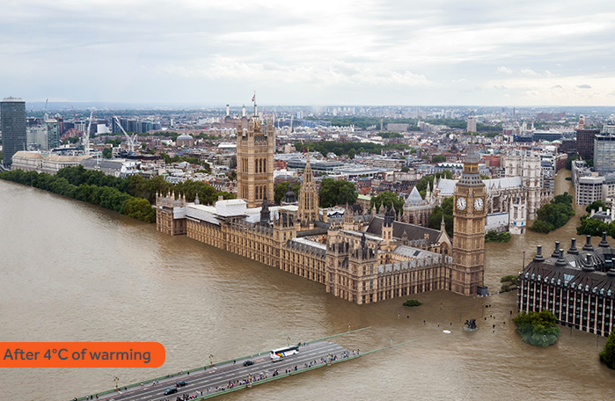
London
After 4°C of warming
Source: Climate Central
Notes:
Script: Here is what the UK’s parliament building with Big Ben would look like with 4 degrees Celsius of warming.

Slide 20
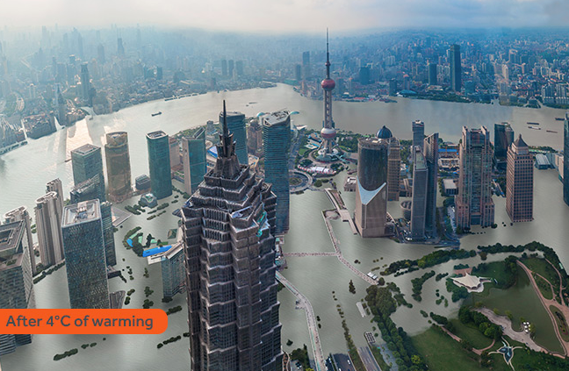
Shanghai
After 4°C of warming
Source: Climate Central
Notes:
Script: And here is what central Shanghai would look like with 4 degrees Celsius of warming.

Slide 21
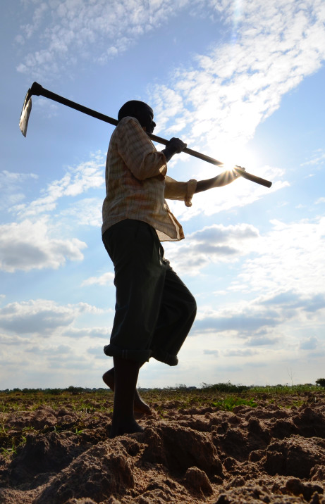
By 2020, in some countries, yields from rain-fed agriculture could be reduced by up to 50%. Agricultural production, including access to food, in many African countries is projected to be severely compromised. This would further adversely affect food security and exacerbate malnutrition.
-IPCC AR5
Notes:
<Read from the slide>

Slide 22
Your Goals
Reduce greenhouse gas levels by 2100 at a level that keeps global warming well below 2°C above preindustrial levels.
Agree on a deal to share costs of mitigation and adaptation fund to aid most vulnerable nations.
Notes:
Script: Delegates, your goal today is to reduce reduce greenhouse gas levels by 2100 at a level that keeps global warming well below 2 degrees celsius above preindustrial levels. To do this, please agree on a deal to share the costs of taking on this challenge and aid less developed nations.

Slide 23
Decision 1: Fossil Fuel Emissions
You will set:
Year GHG emissions in your bloc stop growing (if any)
Year (if desired) GHG emissions begin to fall
If emissions will fall, at what rate (% per year)
Developed Countries Fossil Fuel Annual Emissions
15 B
2. Start reduction in 2050
tonsC0₂/year
1. Stop growth in 2040
10 B
3. Annual
reduction
1%
5 B
Business as Usual (BAU)
3%
5%
0
2000
2020
2040
2060
2080
2100
Notes:
Script: To achieve your goals, you will submit pledges that determine when your region’s greenhouse gas emissions will peak, decline, and fall (if you desire). First, you will set the year your emissions will stop growing. Then you will determine the year that your emissions will begin to decline (if at all). And then at what rate they will fall each year. Here’s an example.

Slide 24

Decision 2: Forestry and Land-use
Prevent Deforestation ( 0 – 100%)
0 %= continues BAU deforestation path
100% = gradually preventing deforestation over coming decades.
Promote Afforestation ( 0 – 100%)
0 %= no new area set aside for afforestation
100% = gradually promoting afforestation over coming decades.
Notes:
Script: Then you will determine your regions efforts to address deforestation, or cutting down trees, and promote afforestation, or planting trees in new areas. You pick a number within 0 to 100%, where 100% represents the maximum amount of effort that your region could put towards this.

Slide 25

Decision 3: Climate Finance
Goal: $100 Billion per year
The Green Climate Fund provides aid to vulnerable countries for:
Disaster relief
Food and water
Immigration and refugees
Emission reductions
Decisions:
How much will you contribute?
Or, how much do you need?
Terms and conditions for funds?
Notes:
Script: The last decision your group faces is the financing for your work to address and adapt to climate change. At previous climate negotiations negotiators have set a goal to secure a hundred billion dollars in climate financing per year. Determine whether you will contribute to this fund or request money from it and how much.

Slide 26
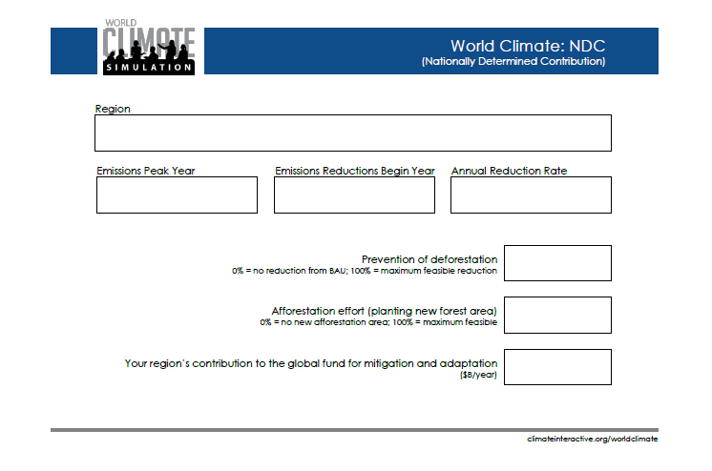
Notes:
<Make sure every group has a sheet like this.>

Slide 27
After you prepare your proposal…
Present a 2 minute plenary presentation by representative of each delegation describing their emissions proposal, their Fund commitment and why.
Designate a representative to give your Bloc’s speech.
Notes:
Script: After the first round of negotiations each group will have the opportunity to give a two minute speech to outline their policies to others and explain the reasons for their choices. Please designate a representative from your group to give this intervention. Good luck!

Slide 28
Proposal Summary
 | Emissions Peak Year | Reductions Begin Year | Annual Reduction Rate (%/year) | Prevent Deforestation (0-100% = max effort, zero emissions) | Promote Afforestation (0-100% = max effort, zero emissions) | Contribution to, or request from Green Climate Fund ($ Billion/yr)
United States | 2100 | 2100 | 0% | 0% | 0% | $0
European Union | 2100 | 2100 | 0% | 0% | 0% | $0
Other Developed | 2100 | 2100 | 0% | 0% | 0% | $0
China | 2100 | 2100 | 0% | 0% | 0% | $0
India | 2100 | 2100 | 0% | 0% | 0% | $0
Other Developing | 2100 | 2100 | 0% | 0% | 0% | $0
Example | 2075 | 2085 | 1.0%/year | 80% | 10% | $10 B/yr
Notes:
<make sure this is drawn up on a board or large piece of paper. It can also be projected.>

Slide 29
Proposal Summary
 | Emissions Peak Year | Reductions Begin Year | Annual Reduction Rate (%/year) | Prevent Deforestation (0-100% = max effort, zero emissions) | Promote Afforestation (0-100% = max effort, zero emissions) | Contribution to, or request from Green Climate Fund ($ Billion/yr)
United States
European Union
Other Developed
China
India
Other Developing
Example | 2075 | 2085 | 1.0%/year | 80% | 10% | $10 B/yr

Slide 30
Proposal Summary
 | Emissions Peak Year | Reductions Begin Year | Annual Reduction Rate (% / year) | Prevent Deforestation (0-100% = max effort, zero emissions) | Promote Afforestation (0-100% = max effort, zero emissions) | Contribution to, or request from Green Climate Fund ($ Billion/yr)
Developed | 2100 | 2100 | 0% | 0% | 0% | $0
Developing A | 2100 | 2100 | 0% | 0% | 0% | $0
Developing B | 2100 | 2100 | 0% | 0% | 0% | $0
Example | 2075 | 2085 | 1.0%/year | 80% | 10% | $10 B/yr

Slide 31
Proposal Summary
 | Emissions Peak Year | Reductions Begin Year | Annual Reduction Rate (% / year) | Prevent Deforestation (0-100% = max effort, zero emissions) | Promote Afforestation (0-100% = max effort, zero emissions) | Contribution to, or request from Green Climate Fund ($ Billion/yr)
Developed
Developing A
Developing B
Example | 2075 | 2085 | 1.0%/year | 80% | 10% | $10 B/yr

Slide 32
Temperature Change
Business as Usual
- 4.5°C
A - 3.5°C
B - 2.6°C
C - 2°C
D - 1.5°C
Notes:
<use this slide after the plenary speeches in the first round, before the pledges are entered into C-ROADS>
Script: Thank you delegates. We will be using the C-ROADS climate policy simulator to determine the impact of your pledges, but before we do that, I want you to use the simulator between your ears—your brain. Looking at the policies that have been put forth, how far do you think we have gotten to achieving our goal?
Raise your hand if you think we have made some impact and our lower than business as usual?
Raise your hand if you think we’ve gotten below 3.5°C, A?
How about below 2.6°C, B?
Anyone think we’ve gotten below 2°C, C? or 1.5°C, D? Thanks.
Now let’s take a look at C-ROADS and see where we actually got to.

Slide 33
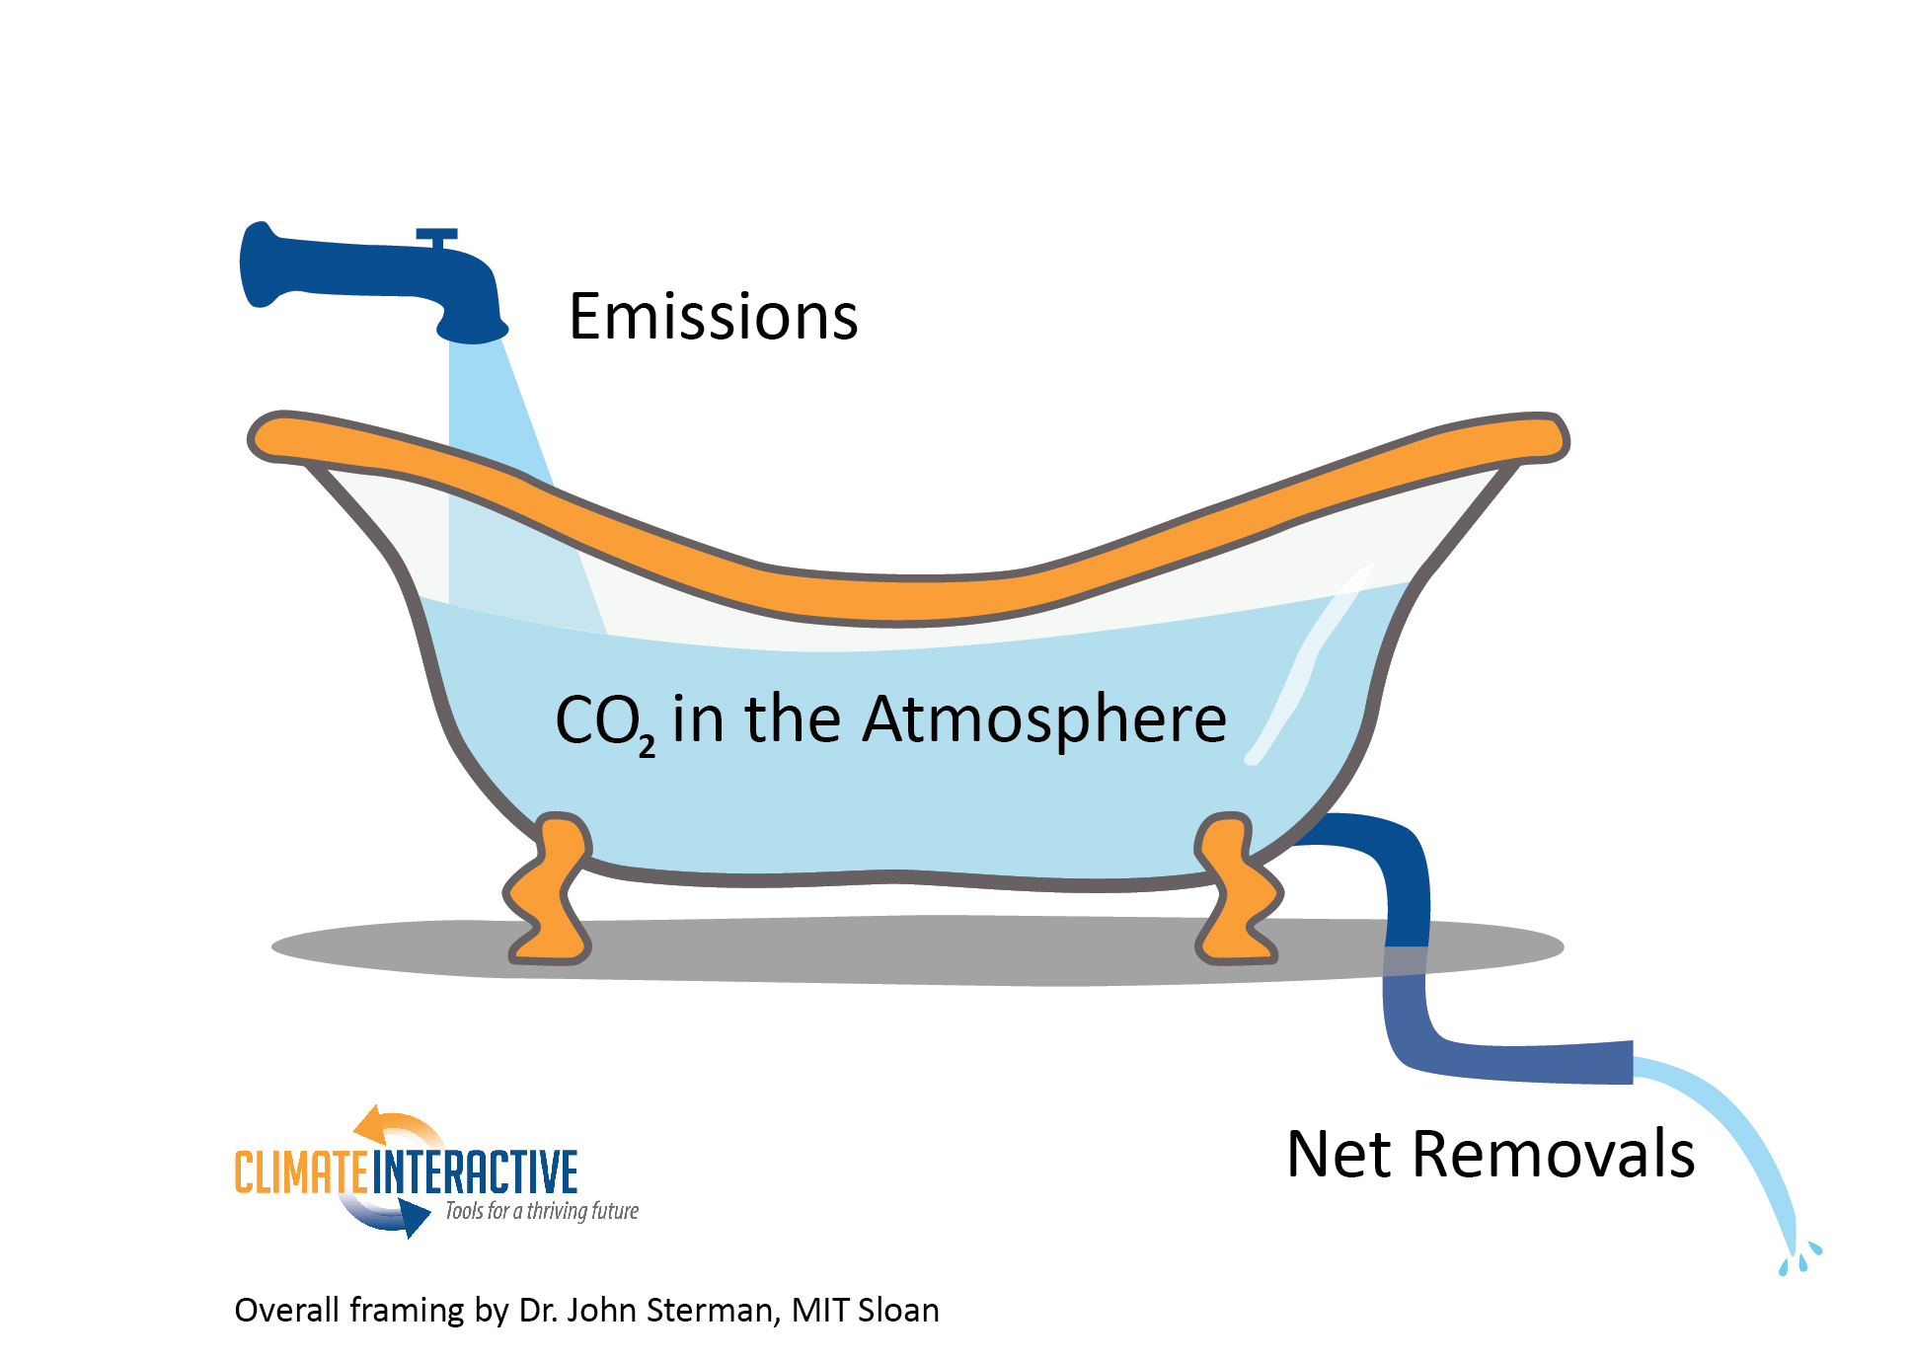

Slide 34
DEBRIEF SESSION

Slide 35
How do you feel?

Slide 36
What did you learn?

Slide 37
Given how you feel, and what you have learnt, what actions will you take?
Notes:
Colour code participants responses to these questions with either these colours, or any other three colours of note cards you might have. Put each set of note cards into a separate envelope for Juliette Rooney-Varga’s research.

Slide 38
Are there situations that might hinder you from taking action on climate change?

Slide 39

For more information or to lead the free exercise yourself, contact:
info@climateinteractive.org

Slide 40


Slide 41
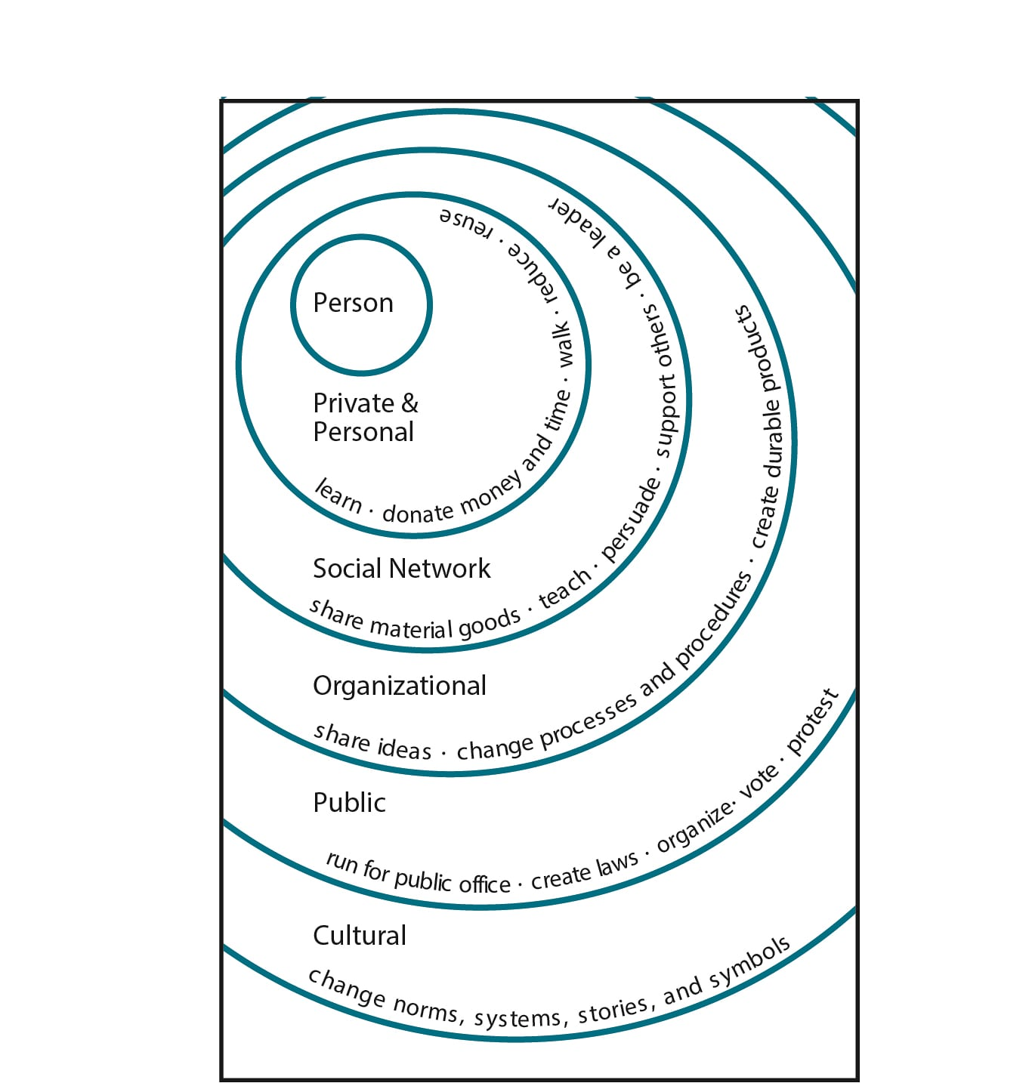
What can you do?
Illustration by Elise Amel
Notes:
Source: https://www.theguardian.com/environment/climate-consensus-97-per-cent/2017/may/19/study-inspiring-action-on-climate-change-is-more-complex-than-you-might-think

Slide 42
Benefits of Climate Action
The US would save billions in health care costs by 2030:
Prevent ~295,000 premature deaths from air pollution (ozone and particulates) caused by fossil fuel use
Additional savings could prevent ~29,000 ER visits/yr for childhood asthma and 15M adult hours lost at work/yr
Diseases and pathogens spread slower in colder climates with less flooding
Development of new technologies for renewable energy sources and transportation
Cost-savings from monetized health benefits: ~$800B/year for clean power and $400B/year for clean transportation: ~$1.2 Trillion/year
Fewer heat waves resulting in heat strokes and deaths
Preservation of vulnerable ecosystems
Notes:
1. Shindell, Drew T., Yunha Lee, and Greg Faluvegi. "Climate and Health Impacts of US Emissions Reductions Consistent with 2 °C." Nature Climate Change Nature Climate Change 6.5 (2016): 503-507.
2. "Human Health." Climate Impacts on Human Health. EPA.

Slide 43
~1.5 ºC of warming
Sea level rise this century ~0.40m
Decrease in global production of staple crops:
Wheat -6-20%
Maize -6-26%
Moderate glacial melting
~70% of coral reefs undergo coral bleaching
Increase in agriculture at high altitudes
Notes:
3. Schleussner, C.-F., T. K. Lissner, E. M. Fischer, J. Wohland, M. Perrette, A. Golly, J. Rogelj, K. Childers, J. Schewe, K. Frieler, M. Mengel, W. Hare, and M. Schaeffer. "Differential Climate Impacts for Policy-relevant Limits to Global Warming: The Case of 1.5 °C and 2 °C." Earth Syst. Dynam. Discuss. Earth System Dynamics Discussions 6.2 (2015): 2447-2505.

Slide 44
~2 ºC of warming
Sea level rise this century ~0.50m
Decrease in global production of staple crops:
Wheat -8-37%
Maize -6-38%
Severe glacial melting
~8% reduction of access to freshwater (compared to today)
~4% increase in the global proportion of land under drought (compared to today)
9-31% of plant and animal species will be committed to extinction
Committed warming (millennia) +2-3.8 ̊C
Long-term equilibrium sea level rise (millennia) ~2-10 m
~90% of coral reefs undergo coral bleaching
Notes:
3. Schleussner, C.-F., T. K. Lissner, E. M. Fischer, J. Wohland, M. Perrette, A. Golly, J. Rogelj, K. Childers, J. Schewe, K. Frieler, M. Mengel, W. Hare, and M. Schaeffer. "Differential Climate Impacts for Policy-relevant Limits to Global Warming: The Case of 1.5 °C and 2 °C." Earth Syst. Dynam. Discuss. Earth System Dynamics Discussions 6.2 (2015): 2447-2505.
6. A. Levermann, P. U. Clark, B. Marzeion, G. A. Milne, D. Pollard, V. Radic, A. Robinson, The multimillennial sea-level commitment of global warming. Proceedings of the National Academy of Sciences 110, 13745-13750 (2013); published online EpubAugust 20, 2013 (10.1073/pnas.1219414110).

Slide 45
2-3 ºC of warming
Sea level rise this century ~0.90m
~14% reduction of access to freshwater (compared to today)
~ 6% increase in the global proportion of land under drought (compared to today)
Specifically South America will be most affected
Doubling of wildfire damage compared to +1-2 ºC
~21-52% of plant and animal species committed to extinction
Committed warming (centuries to millennia) +3.5–5.8 ºC
Long-term equilibrium sea level rise ~10-15 m
With a 5 m sea level rise, Miami, most Manhattan, Central London, Bangkok, Bombay and Shanghai would be flooded.

Slide 46
3-4 ºC of warming
Sea level rise this century ~1.0 m
~ 7.4% increase in the global proportion of land under drought (compared to today)
Chances of drought rise from 5% now (one every 20 years) to 50% by 2030, and to 90% by 2100 in the Amazon
Desertification of Central America and Northern South America, including the Amazon Rainforest
~17% reduction of access to freshwater (compared to today)
Doubling of wildfire damage compared to +2-3 ̊C
~21-52% of plant and animal species committed to extinction due to climate change alone
Hurricanes increase in severity (category 5.5 instead of 5) Committed warming (centuries to millennia) +5.8–7.8 ̊C
Long-term equilibrium sea level rise ~13-15 m
Notes:
10. F. Ackerman, E. A. Stanton, Climate Economics: The State of the Art. (Routledge, New York, NY, 2013), pp. 187.
11. Cox, Peter M., Phil P. Harris, Chris Huntingford, Richard A. Betts, Matthew Collins, Chris D. Jones, Tim E. Jupp, José A. Marengo, and Carlos A. Nobre. "Increasing Risk of Amazonian Drought Due to Decreasing Aerosol Pollution." Nature 453.7192 (2008): 212-15. Web.

Slide 47
+4 ºC of warming
Multi-meter sea level rise within 50-150 years possible
Widespread increase in the frequency of drought across the globe (~60% increase)
Desertification of Mediterranean Europe
Intense and frequent heat waves and floods in many areas across globe
Thawing of permafrost potentially releases CO2 and CH4 to the atmosphere, with further temperature rise
Committed warming (centuries to millennia): + >6 ˚C
Long-term equilibrium sea level rise (millennia): ~13-15 m
Notes:
5. C. Prudhomme, I. Giuntoli, E. L. Robinson, D. B. Clark, N. W. Arnell, R. Dankers, B. M. Fekete, W. Franssen, D. Gerten, S. N. Gosling, S. Hagemann, D. M. Hannah, H. Kim, Y. Masaki, Y. Satoh, T. Stacke, Y. Wada, D. Wisser, Hydrological droughts in the 21st century, hotspots and uncertainties from a global multimodel ensemble experiment. Proceedings of the National Academy of Sciences, 111.9(2013): 3262–3267.
6. A. Levermann, P. U. Clark, B. Marzeion, G. A. Milne, D. Pollard, V. Radic, A. Robinson, The multimillennial sea-level commitment of global warming. Proceedings of the National Academy of Sciences 110, 13745-13750 (2013); published online EpubAugust 20, 2013 (10.1073/pnas.1219414110).
7. S. Solomon, D. Battisti, S. C. Doney, K. Hayhoe, I. M. Held, D. P. Lettenmaier, D. Lobell, D. Matthews, R. Pierrehumbert, M. Raphael, R. Richels, T. L. Root, K. Steffen, C. Tebaldi, G. W. Yohe, Climate stabilization targets: Emissions, concentrations, and impacts over decades to millenia. (National Academy of Sciences, Washington DC, 2010), pp. 190.
8. J. Hansen, P. Kharecha, M. Sato, V. Masson-Delmotte, F. Ackerman, D. J. Beerling, P. J. Hearty, O. Hoegh-Guldberg, S. L. Hsu, C. Parmesan, J. Rockstrom, E. J. Rohling, J. Sachs, P. Smith, K. Steffen, L. Van Susteren, K. von Schuckmann, J. C. Zachos, Assessing "dangerous climate change": required reduction of carbon emissions to protect young people, future generations and nature. PLoS One 8, e81648 (2013)10.1371/journal.pone.0081648).
9. Lynas, Mark. Six Degrees: Our Future on a Hotter Planet. Washington, D.C.: National Geographic, 2008. Print.

Slide 48

Let’s play a short version of World Climate
Notes:
For debrief: Overview of pledges coming out of Paris

Slide 49
USD billion
as of Nov 2017
Notes:
Source: http://www.greenclimate.fund/how-we-work/resource-mobilization

Slide 50

Reference
60
4.2ºC
in 2100
50
40
Greenhouse Gas Emissions (GtonsCO₂e / year)
30
Other Developing
China
Other Developed
US
EU
India
20
10
0
2000
2020
2040
2060
2080
2100

Slide 51
Current Plans
60
3.3ºC
in 2100
50
40
Greenhouse Gas Emissions (GtonsCO₂e / year)
30
Other Developing
China
Other Developed
US
EU
India
20
10
0
2000
2020
2040
2060
2080
2100
*All countries achieve their NDCs by the target year, and their mid-century strategy (MCS) if they have one.
Notes:
Script: When the contributions from Paris are added up we see that this puts the world on course for 3.5 degrees Celsius. Some progress, but still well above the goal of staying below 2 degrees Celsius. Note here that most countries have only made formal policies up to the year 2030. The US, EU, and Other Developed Countries are already planning to reduce their emissions and China has pledged to peak their carbon dioxide emissions in 2030. <flip back and forth between this and the previous slide to help the audience see the difference each group has made.>

Slide 52
Current Plans plus:
developed countries reduce 80% by 2050 and
China peaks CO₂e in 2030, then reduces at 3%/year
60
2.8ºC
in 2100
50
40
Greenhouse Gas Emissions (GtonsCO₂e / year)
30
Other Developing
China
Other Developed
US
EU
India
20
10
0
2000
2020
2040
2060
2080
2100
*US and all developed countries achieve their NDC by target year, then decrease to 80% below reference year CO2eq by 2050, and then decrease at 4% per year

Slide 53
Current NDCs and MCS,
Other Developed Follow US*
Other Developing Follow China
60
1.9ºC
in 2100
50
40
Greenhouse Gas Emissions (GtonsCO₂e / year)
30
Other Developing
China
Other Developed
US
EU
India
20
10
0
2000
2020
2040
2060
2080
2100
*US and all developed countries achieve their NDC by target year, then decrease to 80% below reference year CO2eq by 2050, and then continue rates of decline

Slide 54
Ratchet to 1.5
60
1.5ºC
in 2100
50
40
Greenhouse Gas Emissions (GtonsCO₂e / year)
30
Other Developing
China
Other Developed
US
EU
India
20
10
0
2000
2020
2040
2060
2080
2100
*All achieve NDCs early, then developed decrease at 10% per year and developing decrease at 8% per year.
Notes:
Script: To stay below 1.5 degrees Celsius, which is what many of the most vulnerable countries are asking for, requires immediate reductions in emissions at a very fast rate.

Slide 55
Paris:
Historic global agreement involving almost all nations
But voluntary
Stronger goals: limit warming to "well below 2°C... and pursuing efforts to limit [warming] to 1.5°C”
However, goals without action are meaningless
INDCs submitted from >180 nations
Full implementation of all INDCs leads to 3.5°C of warming
Includes ratchet review process to strengthen INDCs
No requirement for greater ambition or earlier action
"an enhanced transparency framework..." to use "metrics assessed by the [IPCC]" to "ensure methodological consistency.”
No guarantee loopholes and cheating will be prevented

Slide 56
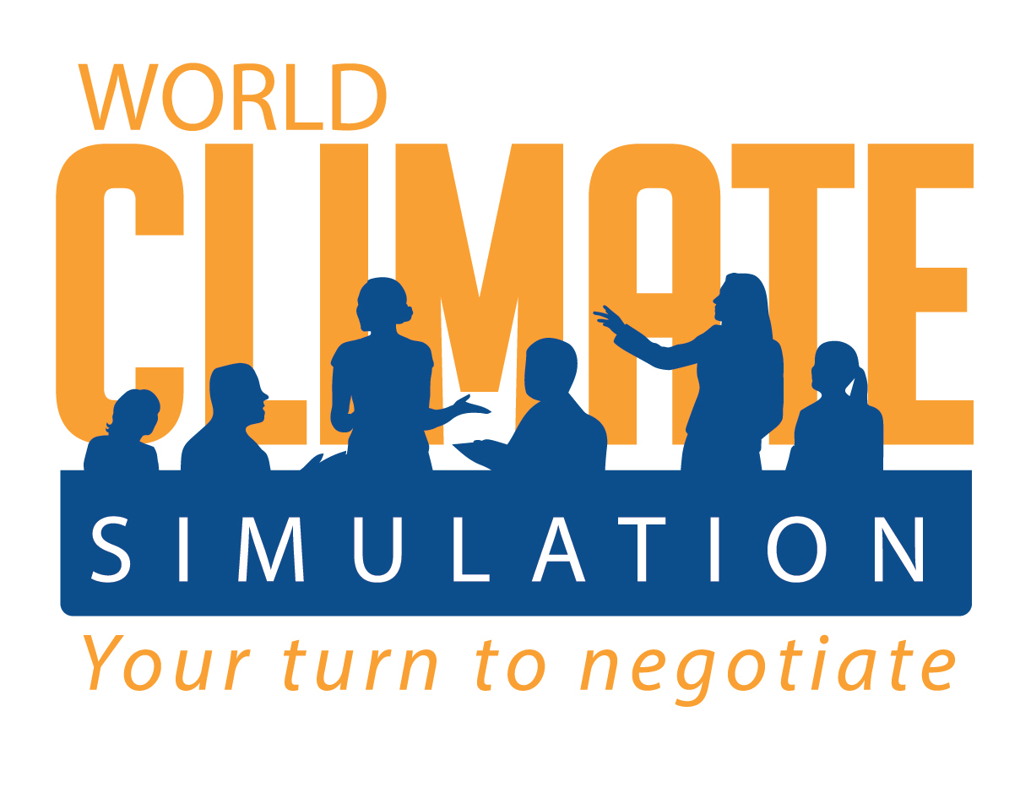
Download
World Climate Materials
And Co-Lead a Session

Slide 57
World Climate Overview Example of a 3-hour session
9:00 - 9:15 Welcoming participants, introduction of the session
9:15 - 9:30 World Climate Introduction, opening speech and climate science (slides 2-26)
9:30 – 9:50 1st round of negotiations
9:50 -10:20 Speeches, C-ROADS, results and bathtub (slides 27-31)
10:20 -10:35 2nd round of negotiations
10:35 - 10:55 Speeches, C-ROADS and results
10:55 - 11:00 Closing the negotiations
11:00 - 12:00 Debrief session

Slide 58

For more information or to organize your own simulation, please visit:
www.climateinteractive.org/worldclimate
All materials are available for free on the website
Don’t forget to register your event!

